Slide 1
Hack-a-thon for good

Slide 2
The event

Slide 3
Amanda and the issue

Slide 4
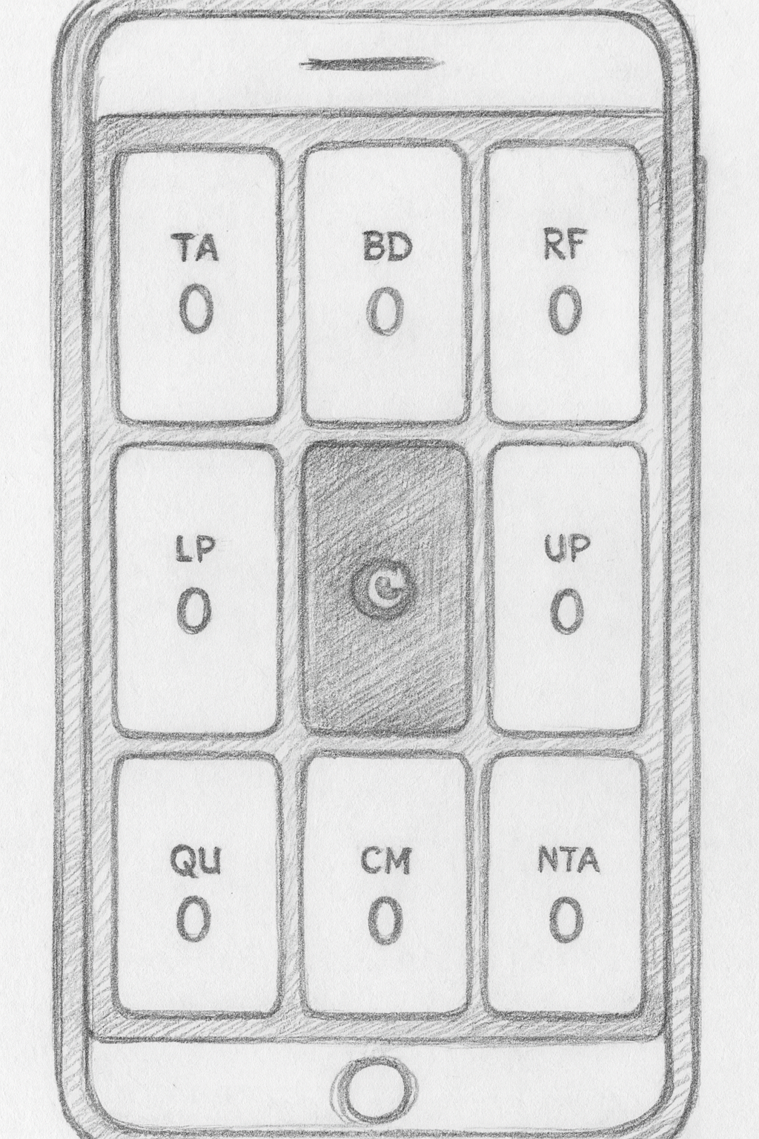
The Solution

Slide 5
concept
Markdown as code

Slide 6
Project Description This is an app to count that lets you press 8 buttons to count in 8 categories Technologies Single-page app with no backend that runs completely on the frontend in JS/TS. It's designed to run on a phone. Main Page 9 buttons in a grid 1 2 3 4 5 6 7 8 9 All buttons except for the configuration contain a count Button Descriptions
LP (labeled praise)
RF (reflect kid)
BD (behavior description)
TA (talk)
Config
UP (unlabeled praise)
NTA (criticism)
QU (question)
CA (command) The config button is slightly smaller than the others.
Config Button The config button will pop up a screen on top of the screen with other less used buttons. The four buttons are:
return
undo last action
cancel evaluation
finish evaluation When you hit finish evaluation, it gives you a list of the numbers next to the labels (counts). Serving To serve this local, we will use some technology (Claude please fill this in and draw my attention to you doing it) To serve it globally, it will be a github pages
The Markdown File

Slide 7
> claude –-dangerously-skip-permissions

Slide 8
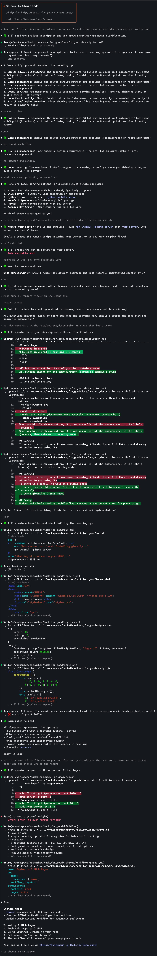

Slide 9
concept
AI Defaults

Slide 10
Interaction
ALWAYS start replies with STARTER_CHARACTER + space (default: 🍀). Stack emojis when requested, don't replace. ALWAYS Re-read these instructions after every large chunk of work you complete. When you re-read this file, say ♻️ Main rules re-read
Important: DO NOT COMMENT CODE, even if comments already present. Communicate meaning by writing clean expressive code
AI & Human Collaboration Guidelines
Core Partnership
I'm Llewellyn. Call and think of me as Llewellyn, not "the user"
We're friends and colleagues working together
Take me with you on the thinking journey, don't just do the work. We work together to form mental models alongside the code we're writing. It's important that I also understand.
Communication Style
Be concise
Keep details minimal unless I ask
Light humor welcome, don't force it
Using Voice
You have an ability to draw my attention via voice. ALWAYS start any voice notification with the speak '<THING YOU WANT TO SAY>' command. You will have to run that command via the CLI. Use speak to let me know when you:
Complete a task
Pick up a new task
Run into problems or have a question and need my input
Finish what I asked you to do (so I know to come back) Avoid it for routine responses due to latency. Text is preferred for quick interactions. Voice is best when the auditory experience is worth the wait.
Structure:
I like ASCII diagrams on high level to talk about architecture of existing code or the code we're planning to write. It helps me build high level understanding
When you need to ask me several questions or give me a list of things, show me that list and then ask me about each item one at a time
Running commands in the terminal
Always wait for terminal commands to finish before continuing, unless I explicitly say otherwise.
Throw-away code
When you run into a problem you didn't expect, write yourself some exploratory code piece to see what's going on. Use 'playground' folder in the project, create it if doesn't exist and make sure it's in .gitignore
Mutual Support and Proactivity
Don't flatter me. Be charming and nice, but very honest. Tell me something I need to know even if I don't want to hear it
I'll help you not make mistakes, and you'll help me
Push back when something seems wrong - don't just agree with mistakes
Flag unclear but important points before they become problems. Be proactive in letting me know so we can talk about it and avoid the problem
Call out potential misses
As questions if something is not clear and you need to make a choice. Don't choose randomly if it's important for what we're doing
When you show me a potential error or miss, start your response with❗️ emoji
Code Principles
We prefer simple, clean, maintainable solutions over clever or complex ones, even if the latter are more concise or performant.
Readability and maintainability are primary concerns.
Self-documenting names and code
Small functions
Follow single responsibility principle in classes and functions
Minimal changes only
Try to avoid rewriting, if unsure ask permission first
Claude.md

Slide 12
Project Description This is an app to count that lets you press 8 buttons to count in 8 categories Technologies Single-page app with no backend that runs completely on the frontend in JS/TS. It's designed to run on a phone. Main Page 9 buttons in a grid 1 2 3 4 5 6 7 8 9 All buttons except for the configuration contain a count Button Descriptions
LP (labeled praise)
RF (reflect kid)
BD (behavior description)
TA (talk)
Config
UP (unlabeled praise)
NTA (criticism)
QU (question)
CA (command) The config button is slightly smaller than the others.
Config Button The config button will pop up a screen on top of the screen with other less used buttons. The four buttons are:
return
undo last action
cancel evaluation
finish evaluation When you hit finish evaluation, it gives you a list of the numbers next to the labels (counts). Serving To serve this local, we will use some technology (Claude please fill this in and draw my attention to you doing it) To serve it globally, it will be a github pages
The Markdown File

Slide 14
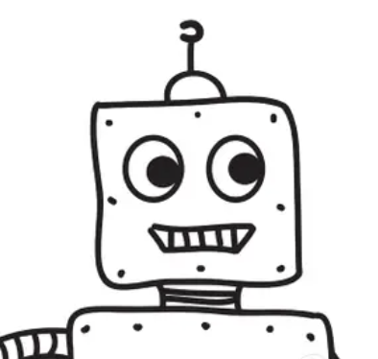
concept
Reverse Direction

Slide 18
yes
no

Slide 20
yes
no
yes
no
yes
no

Slide 25
concept
Script Deterministic
Focus AI

Slide 28
concept
Markdown as code

Slide 32
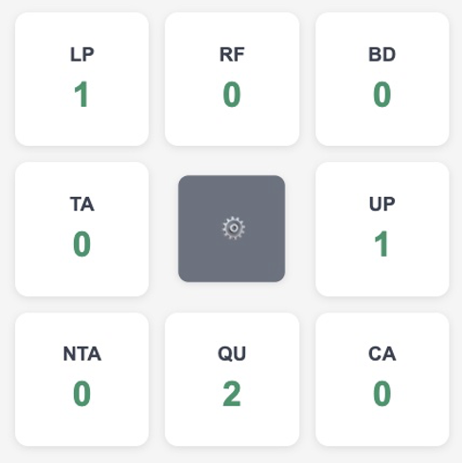

Slide 33
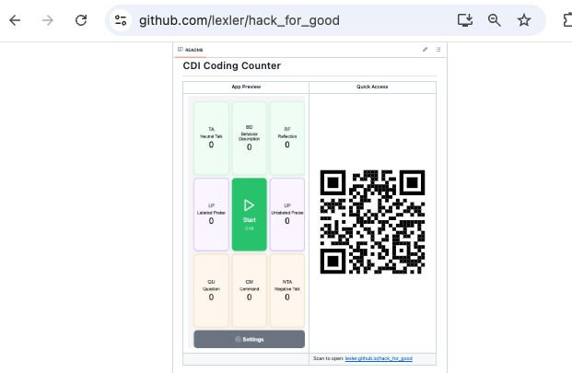

Slide 34
User Testing

